Slide 1

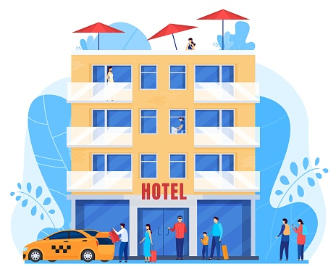
FutureTale
Hotel Reservation
Case Study

Slide 2
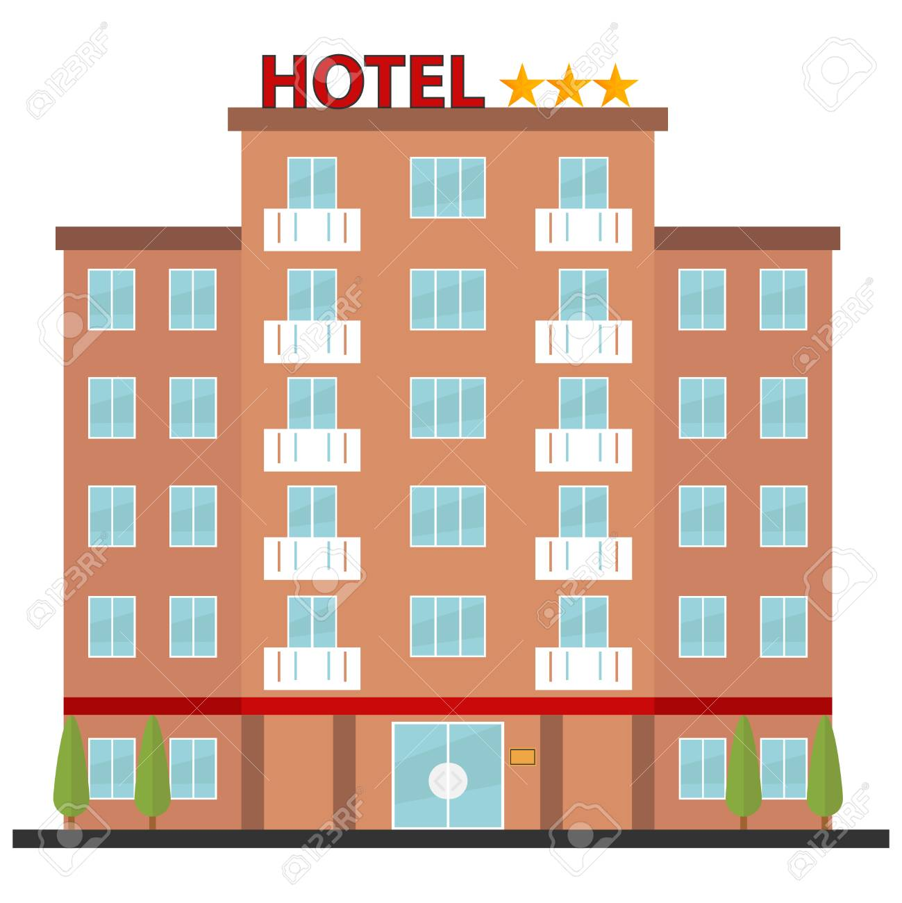
About FutureTale Bank
When you walk into the FutureTale Hotel, you are greeted by an atmosphere inspired by dynamic modernity.
The Chinese Restaurant, Japanese Gourmet Restaurant, Lobby Lounge & Bars, and Grand Ballroom, as well as the guest rooms and suites, meet the most exacting comfort and service standards. Hospitality in the best tradition of the Lagos Oriental Hotel has been reborn.
FutureTale Hotel promises excellent accommodation, business, and leisure experiences with 64 guestrooms, including 9 spacious suites.
Each of our guestrooms, which range in size from 60 to 300 square metres and have enchanting lagoon views, provides guests with a one-of-a-kind combination of luxury and style.
The FutureTale Hotel's guestrooms combine modern style with undeniable comfort, with original artwork complementing the Asian furnishings. The muted colour schemes contrast with the city lights and skyscrapers in the background. All of our rooms include LCD flat-screen televisions, wired or wireless internet access, individual air conditioning control, an in-room safe, complimentary tea and coffee making facilities, and luxurious bathrobes and slippers.

Slide 3
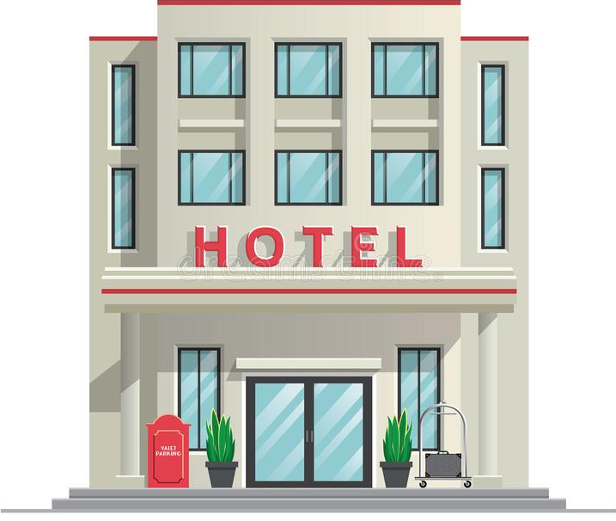
Case Study
The online hotel reservation channels have dramatically changed booking possibilities and customers’ behavior. A significant number of hotel reservations are called-off due to cancellations or no-shows. The typical reasons for cancellations include change of plans, scheduling conflicts, etc. This is often made easier by the option to do so free of charge or preferably at a low cost which is beneficial to hotel guests but it is a less desirable and possibly revenue-diminishing factor for hotels to deal with.
You have been employed as a Data Scientist to explore the data and provide some insights and recommendations?

Slide 4
Data Dictionary
Booking_ID: unique identifier of each booking
no_of_adults: Number of adults
no_of_children: Number of Children
no_of_weekend_nights: Number of weekend nights (Saturday or Sunday) the guest stayed or booked to stay at the hotel
no_of_week_nights: Number of week nights (Monday to Friday) the guest stayed or booked to stay at the hotel
type_of_meal_plan: Type of meal plan booked by the customer:
required_car_parking_space: Does the customer require a car parking space? (0 - No, 1- Yes)
room_type_reserved: Type of room reserved by the customer. The values are ciphered (encoded) by INN Hotels.
lead_time: Number of days between the date of booking and the arrival date
arrival_year: Year of arrival date
arrival_month: Month of arrival date
arrival_date: Date of the month
market_segment_type: Market segment designation.
repeated_guest: Is the customer a repeated guest? (0 - No, 1- Yes)
no_of_previous_cancellations: Number of previous bookings that were canceled by the customer prior to the current booking
no_of_previous_bookings_not_canceled: Number of previous bookings not canceled by the customer prior to the current booking
avg_price_per_room: Average price per day of the reservation; prices of the rooms are dynamic. (in euros)
no_of_special_requests: Total number of special requests made by the customer (e.g. high floor, view from the room, etc)
booking_status: Flag indicating if the booking was canceled or not.

Slide 5

Create a dashboard and share on LinkedIn/Twitter
(Tag @10Alytics)

